Slide 1
MARK DIGITIZING
EMROIDERY DIGITIZING SERVICE
COMPANY BROUCHER
How to place your order

Slide 2
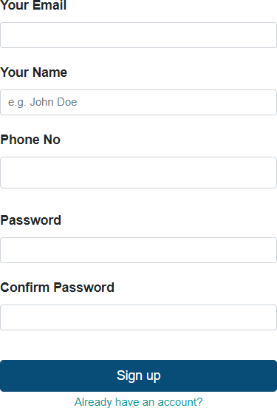
Sign Up
mark@gmail.com
1
Enter Your Email
2
Enter Your Name
+1 (315) 961-7679
3
Enter Your Phone No
M@rkDig$3792
4
Enter Your Password
M@rkDig$3792
5
Re-Enter Your Password

Slide 3
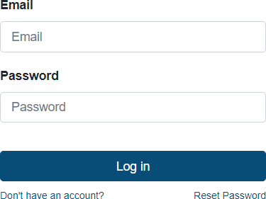
Login
mark@gmail.com
1
Enter Your Email
M@rk
2
Enter Your Password
3
You Can Reset Your Password

Slide 4
User's Profile
Enter Your Name
Enter Your Email
1
2
Enter Your Company Name
Enter Your Phone No
3
4
Enter Your Street
Enter Your City
5
6
Enter Your Zip Code
Enter Your Country
7
8
Enter Your State
10
Click Here

Slide 5
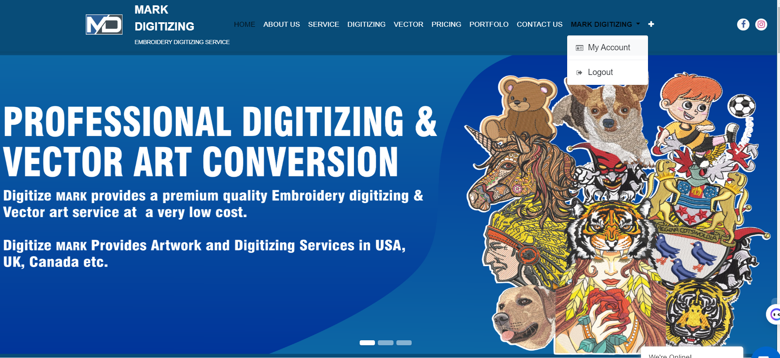
My Account

Slide 6
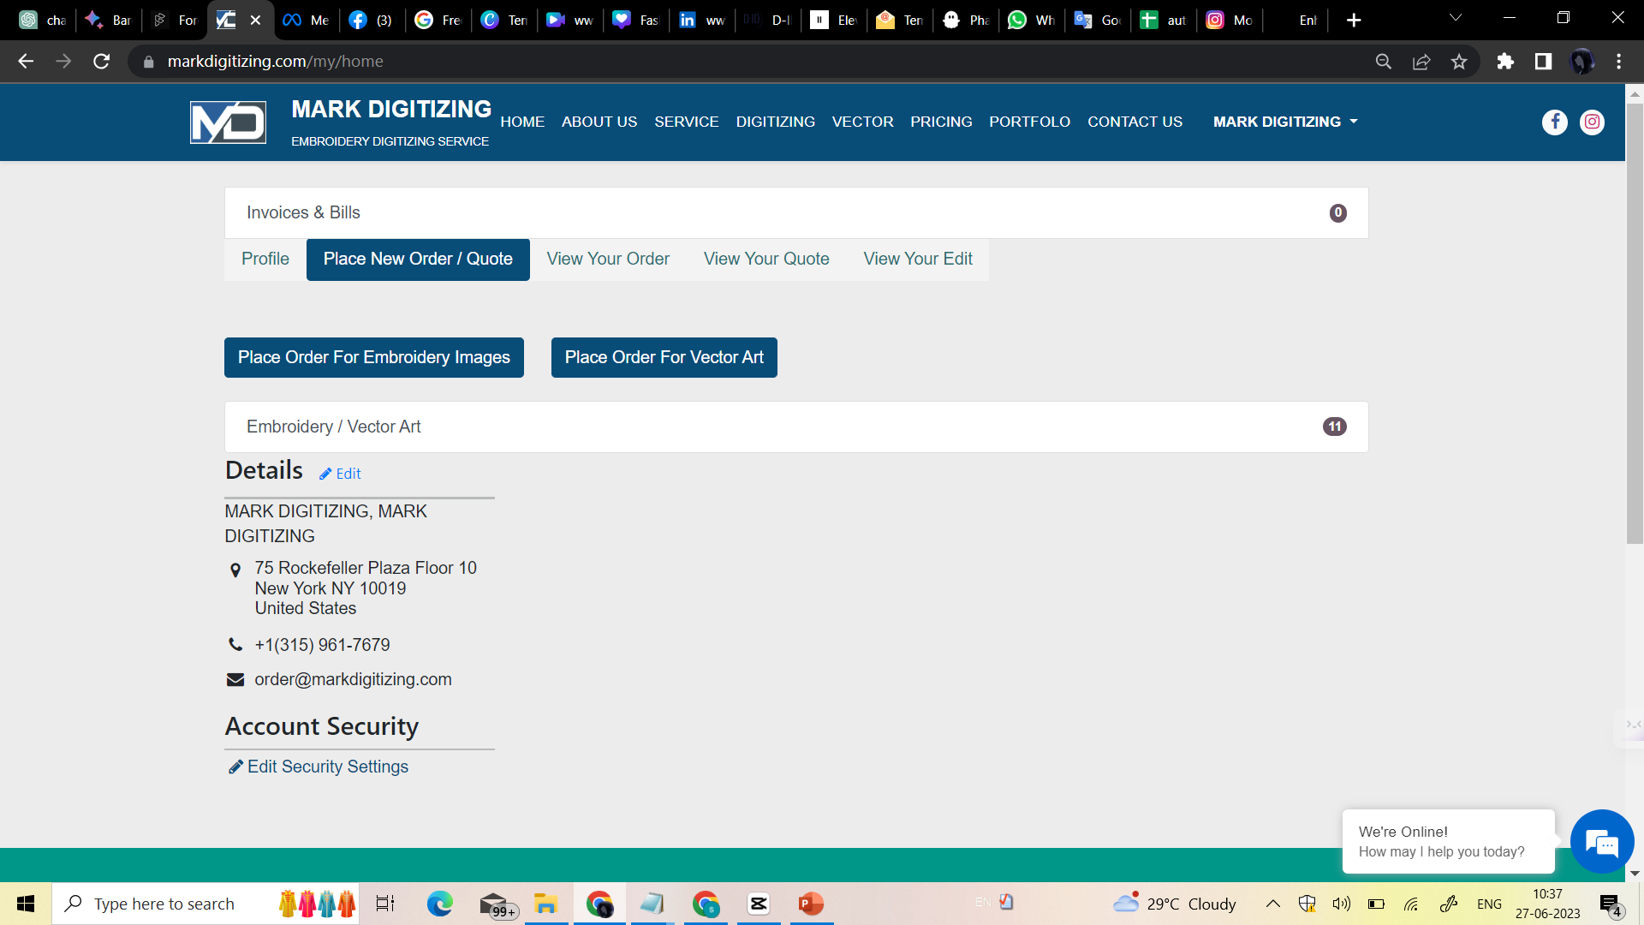
Enter Your Account
1
2
You Can View Your Order
You can Place a New order
For Vector Design
For Embroidery Design

Slide 7
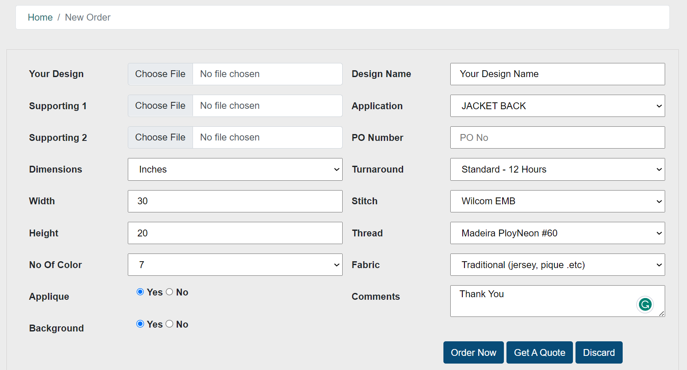
Place Order For Embroidery & Q u o t e
Upload Your Design
Place New Order
Enter Design Name
Select Your Requirements
Enter Your PO No
Select Your Requirements
Select Turnaround Time
Enter Your Size in width
Select Your Requirements
Enter Your in Height
Select Your Requirements
No of colour you want
Select One
Select Your Requirements
Enter Your Message
Select Your Requirements
To place your order click here
For free Quote click here

Slide 8
VIEW YOUR ORDER
Search Order By ID
8
You can check Your Status
Check Sample file Free
After payment Download Original zip File
1
5
7
Your
Order
Id
4
Order Paid
3
Your order in process
2
New
6
Thank You
View Order
Complete Yours Payments
You Can Send Us Edit Order For future Modifications

Slide 9
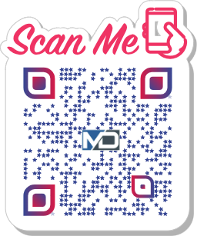
Connect with us.
MARK DIGITIZING
Email
order@markdigitizing.com
website
www.markdigitizing.com
Phone No-
+1 (315) 961-7679
Social Media
@markdigitizing

